Slide 1
26th ACM SIGOPS Chinasys Workshop
Removing Obstacles before Breaking Through the Memory Wall:
A Close Look at HBM Errors in the Field
Ronglong Wu(吴镕龙), Shuyue Zhou, Jiahao Lu, Zhirong Shen, Zikang Xu,
Jiwu Shu, Kunlin Yang, Feilong Lin, and Yiming Zhang
Notes:
Hello everyone, I'm Ronglong Wu from Xiamen University.
Today, I'd like to share with you our recent work,
“Mitigating Write Disturbance in Non-Volatile Memory via Coupling Machine Learning with Out-of-Place Updates”,
which focuses on the write disturbance problem, a prevalent issue in non-volatile memory.

Slide 2
Outline
Background
Analyses and Findings
Calchas: Hierarchical Prediction Framework
Conclusion
Notes:
I will introduce our work from these four parts.

Slide 3
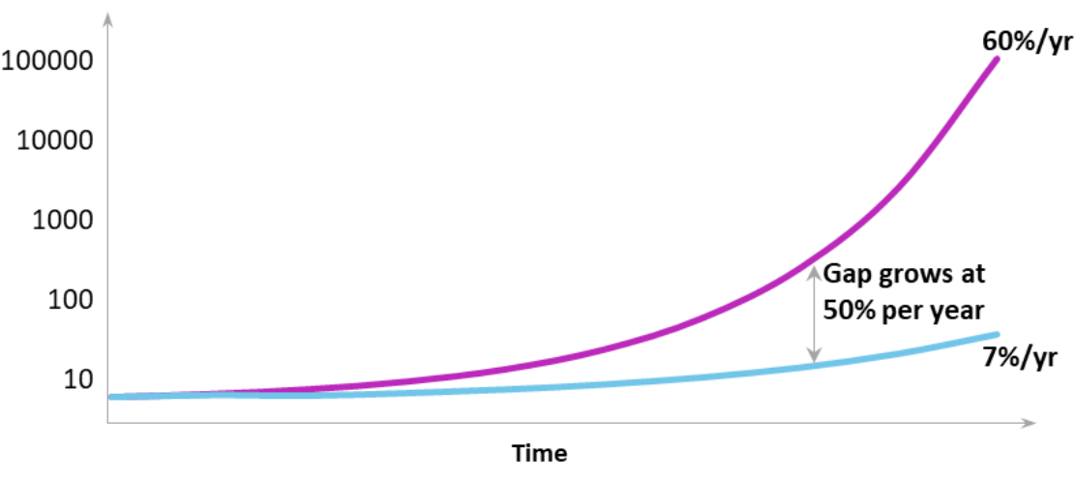
Background: Memory Wall
The gap between computing power and memory bandwidth is continuously widening in modern systems^{[1]}
Processors are improving exponentially, but memory bandwidth is increasing slowly
Processor performance
Memory performance
Performance
Memory wall
Memory wall becomes one of the major obstacles in training LLM models.
[1] Micron Inc., Micron’s Perspective on Impact of CXL on DRAM Bit Growth Rate

Slide 4
Background: High-Bandwidth Memory
HBM is a hopeful technology to overcome the memory wall
Save massive physical space by stack vertically
Offer significantly higher data transfer rates
Introduce reduced power consumption
Die
SID0
SID1
TSVs
Buffer die
Each pseudo channel can be accessed independently

Slide 5
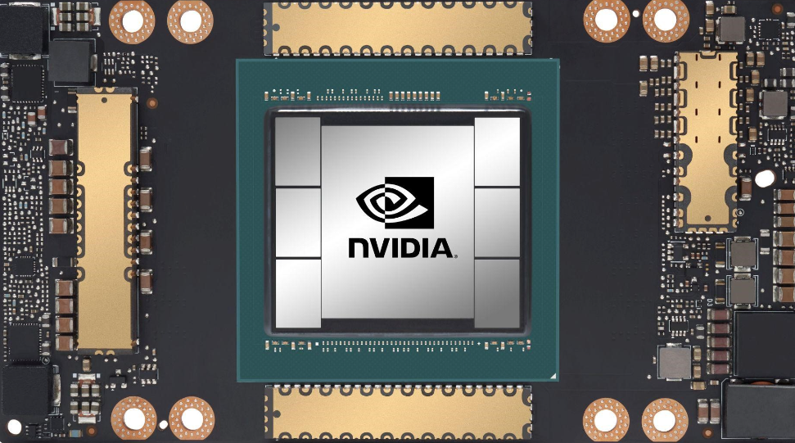
Background: HBM Errors
Disadvantages of HBM Memory
Packed within a DSA devices → Less flexibility
Complex manufacturing process → More special
Equip weaker ECC → More errors
HBM
Example of various micro-bump joint failures in HBM^{[3]}
NVIDIA A100 GPU^{[2]}
Errors in HBM are more common and distinct compared to DRAM, but there is a lack of analysis on HBM errors in real production environments.
[2] NVIDIA A100 Tensor Core GPU. https://www.nvidia.com/en-us/data-center/a100/.
[3] Jun et al. HBM (High Bandwidth Memory) DRAM Technology and Architecture. Proc. of IMW, 2017.

Slide 6
Outline
Background
Analyses and Findings
Calchas: Hierarchical Prediction Framework
Conclusion
Notes:
I will introduce our work from these four parts.

Slide 7
Analyses: Our Dataset
Over 15K DSA devices
60K+ HBM2 memory chips
460M+ errors
19 data centers: diverse services
Two years BMC log
ErrLog_Cycle log: concise but fully recordable
ErrLog_Occurrence log: detailed but difficult to fully retain
Sensor log: temperature, power, etc.
Test dataset released
https://github.com/wrl297/Calchas

Slide 8
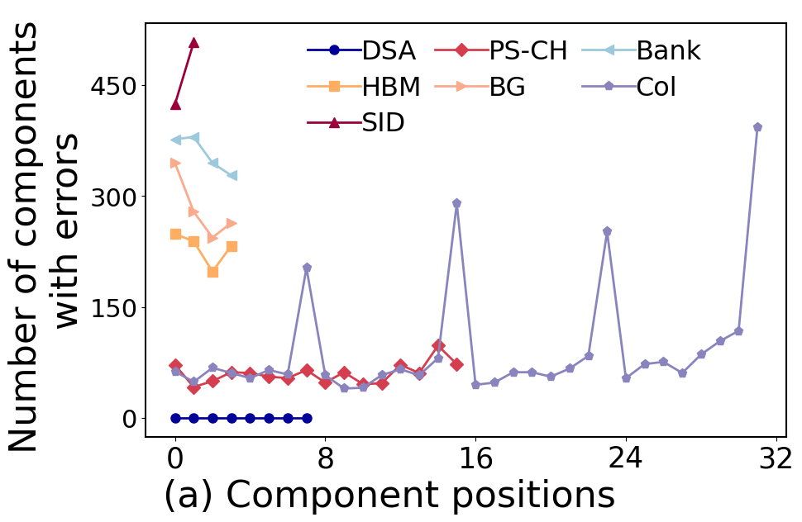
Analyses: Hierarchical Levels
Errors in different positions
E.g., A BankGroup consists of four Banks, each located in different positions. Count the number of errors at each different bank position.
Finding: Errors occurring in the 7th, 15th, 23rd, and 31st columns are 338.4% higher on average than the errors in other column positions.
Root cause: The effects of crosstalk in the HBM may result in data loss

Slide 9
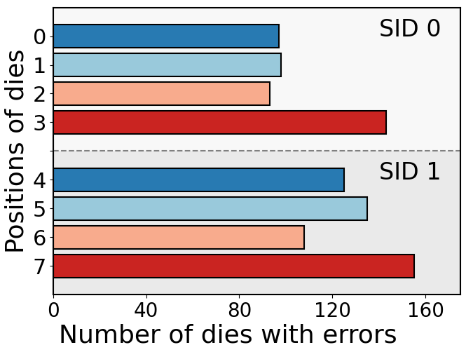
Analyses: Hierarchical Levels
Errors in different positions
Top
Bottom
Finding: Lower SIDs (i.e., SID1) exhibit a higher susceptibility to errors due to the due to poor heat dissipation in the lower SID

Slide 10
Analyses: Error Modes
Typical error modes in a bank
Row-related modes (5.0%)
Single-row
Two-row
Row-dominant
Column-related modes are more commonly observed in HBM, as opposed to the prevalent row-related modes in DRAM
Col-related modes (29.22%)
Single-col
Two-col
Col-dominant

Slide 11
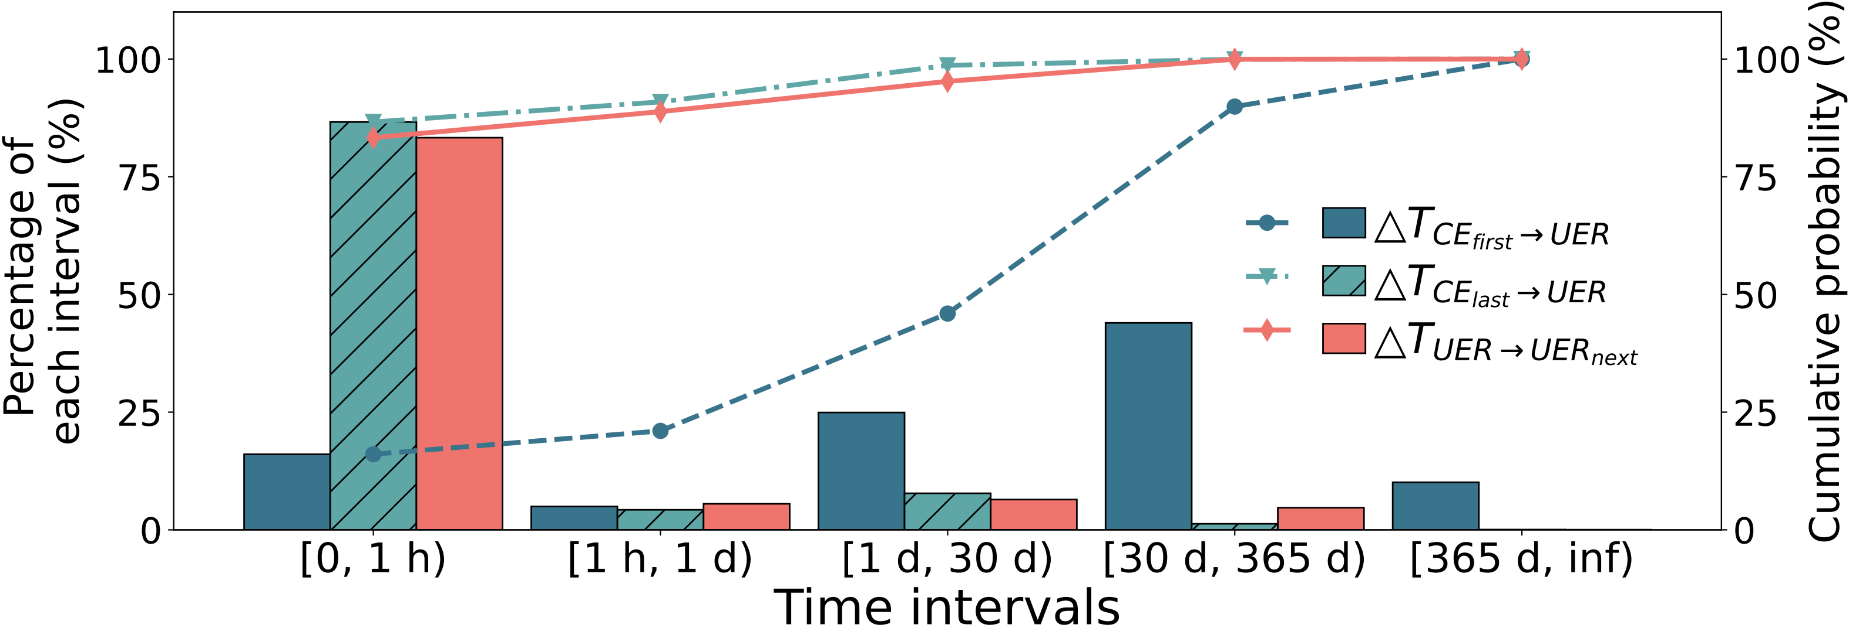
Analyses: Time between Errors
Time interval
$∆T_{{CE}_{first}→UER}$: how soon will the first CE evolve to the first UER?
$∆T_{{CE}_{last}→UER}$: how much time remains to prevent crashes?
$∆T_{UER→{UER}_{next}}$: how long will the next UER occur once appearing a UER?
First CE
Last CE
$$∆T_{{CE}_{last}→UER}$$
Time
$$∆T_{{CE}_{first}→UER}$$
UER
Time
UER
$$∆T_{UER→{UER}_{next}}$$
Next
UER
A significant probability that two successive UERs occur within one hour
Bank may have encountered CEs long time ago
CE
UER
No error

Slide 12
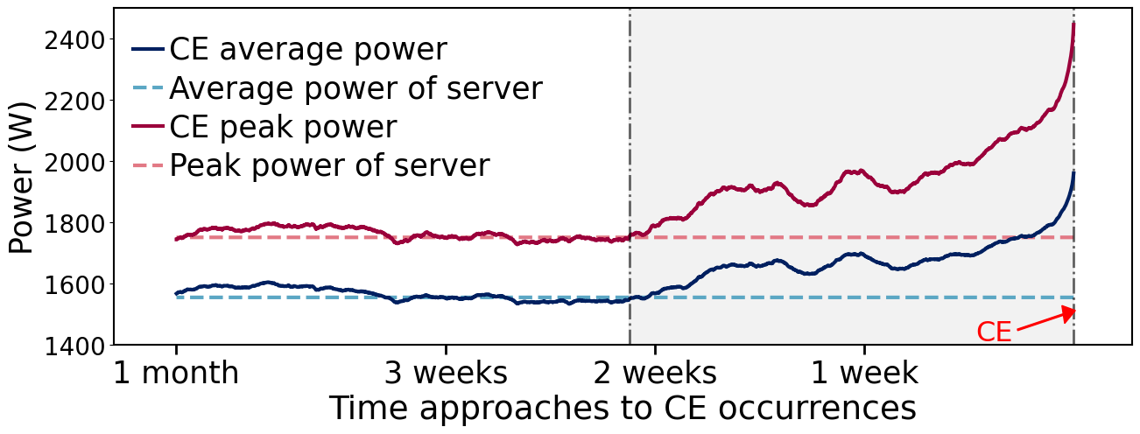
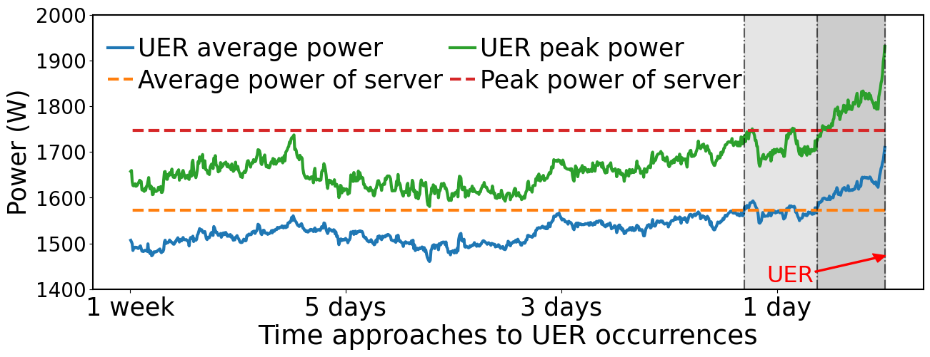
Analyses: Impact of Power
Power trend before errors
UER/CE peak/average power: the peak and average power of last ten minutes
Average and peak power of server: the average of all recorded peak and average power
The average and peak power both exhibit a rapid increase when approaching the error occurrence.
Notes:
Traditional DRAM has reached its physical limits, making it challenging to further increase memory density and capacity.
The emerging NVM, such as Intel's Optane and Everspin's STT-RAM,
is considered a new way to break the scaling constraints of the main memory
due to its DRAM-comparable access performance and higher memory density.
However, as NVM density increases, it faces a significant problem of write disturbances
that impact the reliability of the memory system.

Slide 13
Analyses
Dataset overview (§3.1)
Errors in HBM exhibit strong spatial locality. (§3.2)
Servers that have experienced CE storms may increase the probability of encountering UERs (§3.3)
The temperature distribution of CEs and UERs exhibits significant differences (§3.4)
More details in the paper
Notes:
Traditional DRAM has reached its physical limits, making it challenging to further increase memory density and capacity.
The emerging NVM, such as Intel's Optane and Everspin's STT-RAM,
is considered a new way to break the scaling constraints of the main memory
due to its DRAM-comparable access performance and higher memory density.
However, as NVM density increases, it faces a significant problem of write disturbances
that impact the reliability of the memory system.

Slide 14
Outline
Background
Analyses and Findings
Calchas: Hierarchical Prediction Framework
Conclusion
Notes:
I will introduce our work from these four parts.

Slide 15
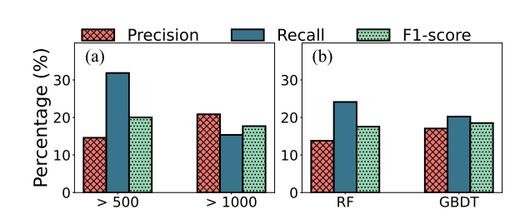
Failed Attempts: CE-based Prediction
Is promise of using CE to predict upcoming UER in HBM?
CE rate indicator^{[4]}: consider a UER may occur when the number of CEs exceed the predefined threshold
CE-based predictor^{[5]}: utilize all the features related to CEs to predict future UER
The prediction methods used in tradiontional DRAM are not working in HBM.
How to conduct a HBM-specific predictor to improve the prediction performance?
[4] Du et al. Predicting uncorrectable memory errors for proactive replacement: An empirical study on large-scale field data. Proc. of EDCC, 2020.
[5] Boixaderas et al. Cost-aware prediction of uncorrected dram errors in the field. Proc. of SC, 2020.
Notes:
Xiaoming Du, Cong Li, Shen Zhou, Mao Ye, and Jing Li.
Predicting uncorrectable memory errors for proactive
replacement: An empirical study on large-scale field
data. In Proceedings of 2020 16th European Depend_x0002_able Computing Conference (EDCC), 2020.

Slide 16
Calchas: Design Guideline
Key factors for designing an efficient predictor
Which features should be utilized to enhance prediction performance?
Component features and statistical features?
How can predictions be made to fully leverage the correlation between features and failures?
Micro-level, HBM-level or server-level?
When is the appropriate time to make predictions?
Period-based or event-driven?
Notes:
Traditional DRAM has reached its physical limits, making it challenging to further increase memory density and capacity.
The emerging NVM, such as Intel's Optane and Everspin's STT-RAM,
is considered a new way to break the scaling constraints of the main memory
due to its DRAM-comparable access performance and higher memory density.
However, as NVM density increases, it faces a significant problem of write disturbances
that impact the reliability of the memory system.

Slide 17
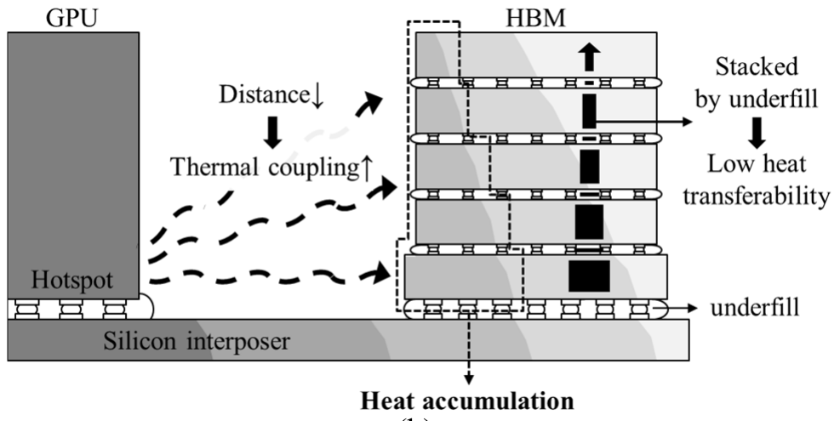
Calchas: Feature Generation
Which features should be utilized to enhance prediction performance?
Component features: number of components experiencing errors
Stack features: one-hot code of SID positions
Sensor features: variation of both power and temperature
The 3D-stacked structure of HBM cause its characteristic (e.g., poor heat dissipation^{[6]}) different from DRAM.
[6] Son et al. Thermal and Signal Integrity Co-Design and Verification of Embedded Cooling Structure With Thermal Transmission Line for High Bandwidth Memory Module. IEEE TCPMT, 1542-1556, 2022.
Notes:
第二张换成散热图

Slide 18
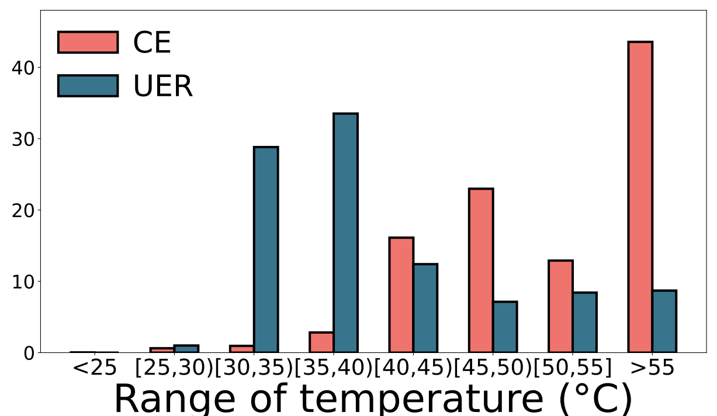
Calchas: Hierarchical Prediction
How can predictions be made to fully leverage the correlation between features and failures?
Micro-level predictor: consider row-level, col-level, and bank-level prediction, respectively
Server-level predictor: capturing the symptom of server failure
Errors may occur along a row, a column, or across in a bank.
Temperature is different before the UER occurrence.

Slide 19
Calchas: Prediction Timing
When is the appropriate time to make predictions?
Period-based approach: perform prediction every cycle
Event-driven approach: prediction triggered by error events
CE
UER
No error
Last prediction time
Last prediction time
Time
Time
Observation
window $T_{o}$
Prediction
window $T_{p}$
Observation
window $T_{o}$
Prediction
window $T_{p}$
Benificial for regularly capturing the symptom
Server-level
predictor
Provide a rapid response to errors
Micro-level
predictor

Slide 20
Calchas: Prediction Performance
Experimental Setup
Ratio of train and test datasets: 70% vs 30% based on timestamp
Metrics: Presion, recall, and F1-score
Models: SVM, GBDT, and RF (sklearn v0.24.2)
Based on RF, Calchas can achieve a highest precision of 58.0%, recall of 74.6%, and F1-score of 64.7% on average.
Notes:
Traditional DRAM has reached its physical limits, making it challenging to further increase memory density and capacity.
The emerging NVM, such as Intel's Optane and Everspin's STT-RAM,
is considered a new way to break the scaling constraints of the main memory
due to its DRAM-comparable access performance and higher memory density.
However, as NVM density increases, it faces a significant problem of write disturbances
that impact the reliability of the memory system.

Slide 21
Outline
Background
Analyses and Findings
Calchas: Hierarchical Prediction Framework
Conclusion
Notes:
I will introduce our work from these four parts.

Slide 22
Conlusion
Key Findings
Lower SIDs (i.e., SID1) exhibit a higher susceptibility to errors
Column-related error modes are prevalent in HBM
Two successive UERs may occur within one hour
Power increase when approaching the error occurrence
......
More details in the paper
Our Solutions: Calchas
Combines features specific to HBM with those used in traditional DRAM
Employs both period-based and event-driven methods to realize the elastic and adaptive prediction
Notes:
In conclusion, our findings indicate that block selection can reduce WD errors, but the selection process incurs high latency.
Further analysis reveals that reducing WD-prone writes can mitigate WD errors.
To address this, we propose LearnWD, which utilizes the two observations to classify the stale blocks and select a suitable cluster for new blocks.
LearnWD further utilizes MinHash to find the most similar stale block to the new block for overwritten to reduce RESET operations
and further decrease WD errors.
Experimental results demonstrate that LearnWD can assist existing encoding schemes in further reducing WD errors.

Slide 23
26th ACM SIGOPS Chinasys Workshop
Thanks & QA
Removing Obstacles before Breaking Through the Memory Wall:
A Close Look at HBM Errors in the Field
XMU ERAS Research Group: https://xmusys.github.io/
Contact email: Ronglong Wu, rlwoo@stu.xmu.edu.cn
Contact Information: Ronglong Wu (rlwoo@stu.xmu.edu.cn)
Notes:
That’all. Thank you.

